Slide 1
Git Tutorial #336546 MLH course
Yuval Ben Sason

Slide 2






Motivation

Slide 3
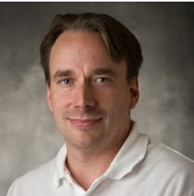
Git
Created by Linus Torvalds in 2005
Invented also Linux
Git is a British slang for a cranky old man
“I’m an egotistical bastard, so I name all my projects after myself. First Linux, now Git”

Slide 4
What’s Git?
Cost-free program for version control –
Creates ‘check points’ (versions) that we can always return to or compare.
Gives you the ability to work simultaneously on the same project with others.
Records and tracks changes in our files and folders​.

